Slide 1
Smart Food Donation
Application Engineering And Development Final Project
Designed By – Kunal Singh Deora
NU-ID: 001664385

Slide 2
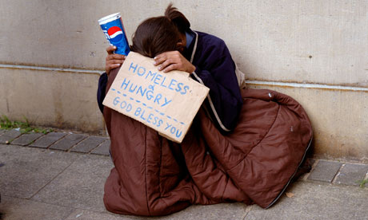
Overview
Hunger is one of the biggest issue in any country. According to latest survey, every one out of six people in America faces hunger and does not receive a proper diet. This is because people are not utilizing their food and eatable items to the maximum. Moreover, American government is spending a huge amount of money to dump the waste food products which can be used in a better way. Smart Food Donation is an attempt to solve these problems.

Slide 3
Objective
Smart Food Donation Application provide intelligent guidance to people for food donation and helps the government authorities in fighting the hunger of poor.
The application utilizes the power of IOT by installing smart sensors in Citizen’s and Restaurant’s refrigerator. The sensor installed in their refrigerator will identify the spoilage of the food by expiry date, odor or by the view of the food.
By the help of this application needy and homeless people will get proper food to it.
People will start contributing for the betterment of the society and there will be a proper utilization of food in the city.
According to the latest survey, US government spends more than $ 1 billion to dump the waste food. This application will surely decrease this amount by significant number.

Slide 4
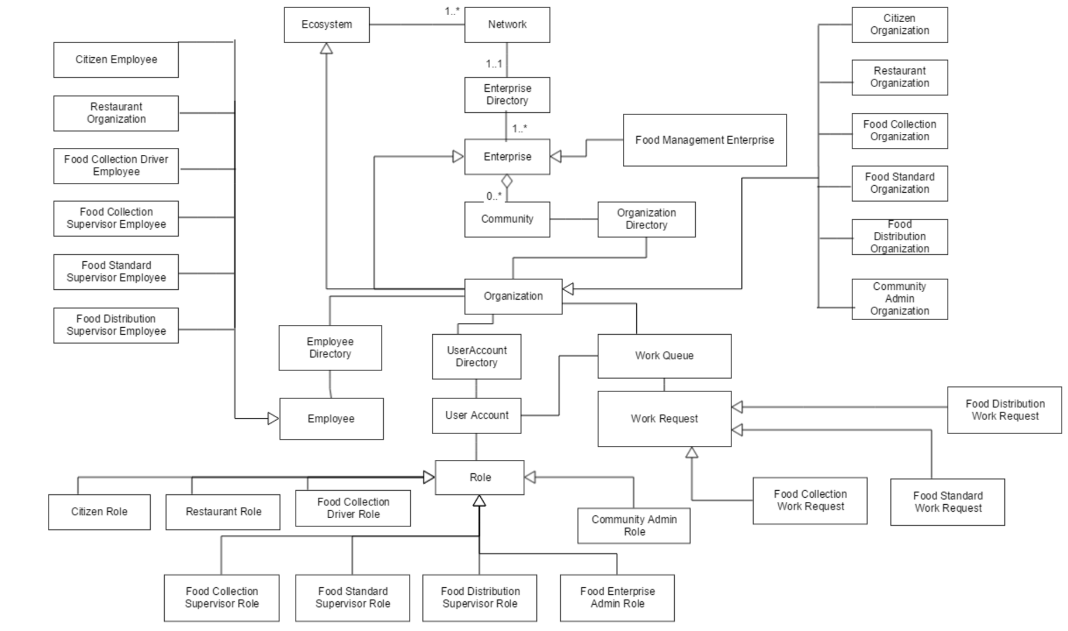

Slide 5
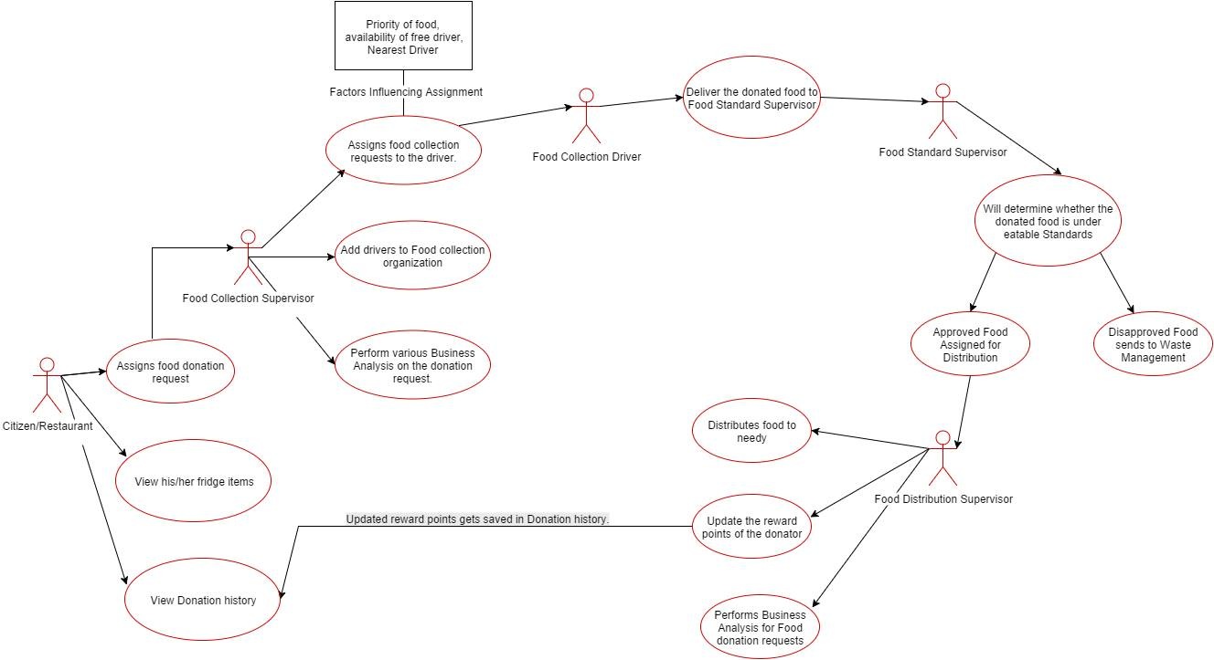
Work Flow of the application

Slide 6
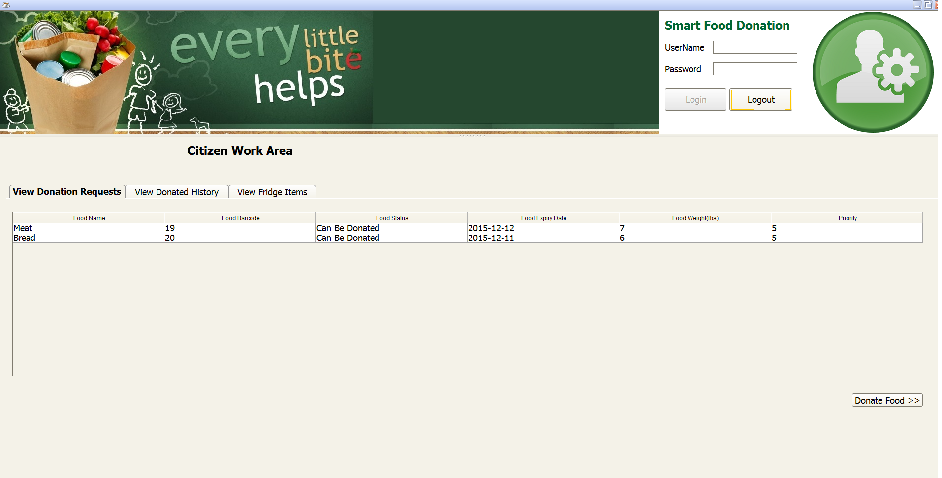

Slide 7
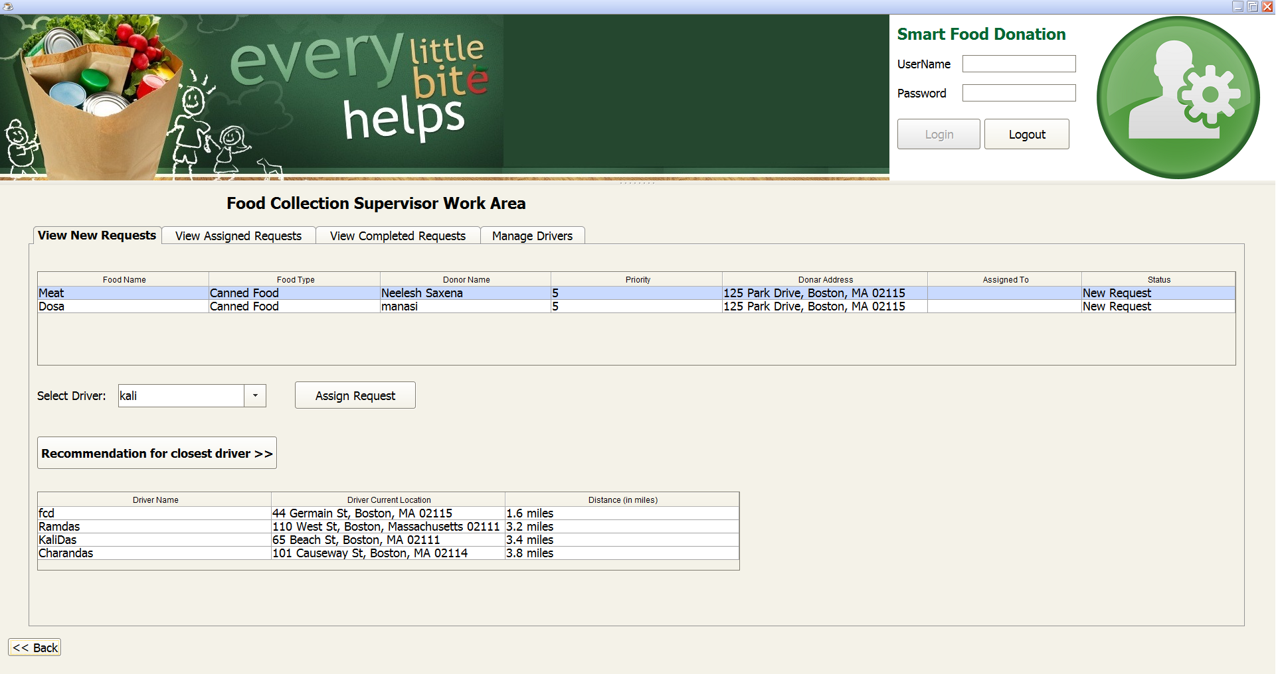

Slide 8
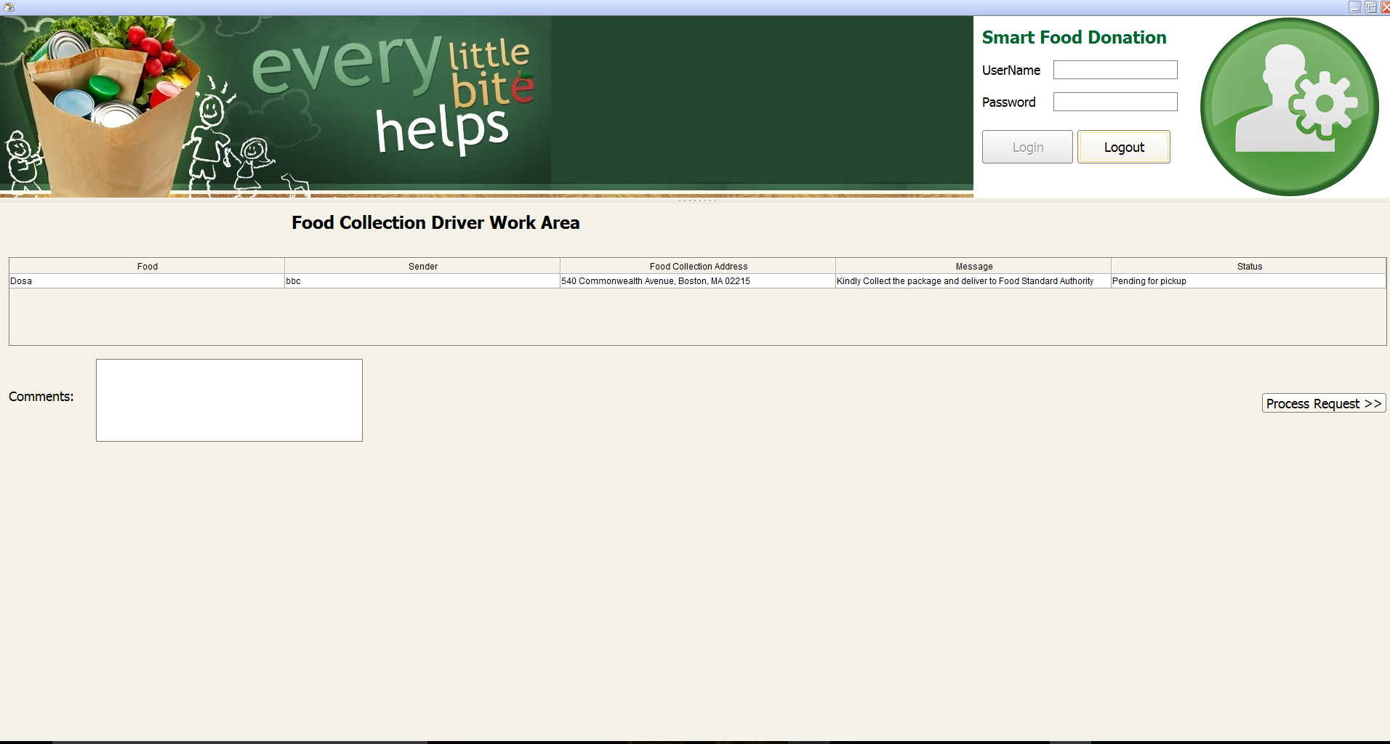

Slide 9
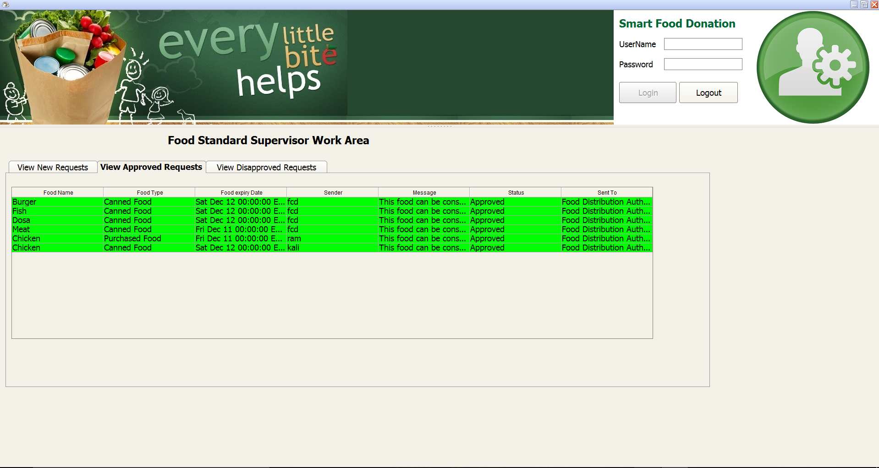

Slide 10
